Slide 1
Topic: Negative Fractions
EQ: How do we add and subtract negative fractions?
Ms. Latham

Slide 2





Topic: Negative Fractions
EQ: How do we add and subtract negative fractions?
Some people freeze dry food at home to keep it for longer. Freeze drying lowers the temperature of food to -40°C.
The temperature of some food is 25°C when placed in the freeze dryer.
Freeze Dry Example
(you don’t need to write this!)
What is the temperature of the food if the temperature is lowered by 10°C?
15 °C
What is the temperature of the food if the temperature is lowered by 10°C?
5 °C
What is the temperature of the food if the temperature is lowered by 5 $\frac{1}{2}$°C?
-$\frac{1}{2}$ °C
What is the temperature of the food if the temperature is lowered by $\frac{1}{2}$°C?
-1 °C
What is the temperature of the food if the temperature is lowered by $\frac{3}{4}$°C?
-1$\frac{3}{4}$°C
What is the temperature of the food if the temperature is lowered by $\frac{1}{2}$°C?
-2$\frac{1}{4}$°C
What is the temperature of the food if the temperature is lowered by $\frac{1}{8}$°C?
-2$\frac{1}{8}$°C
By how many degrees would the temperature need to be lowered by to bring the food to -40°C?
37 $\frac{7}{8}$°C

Slide 3
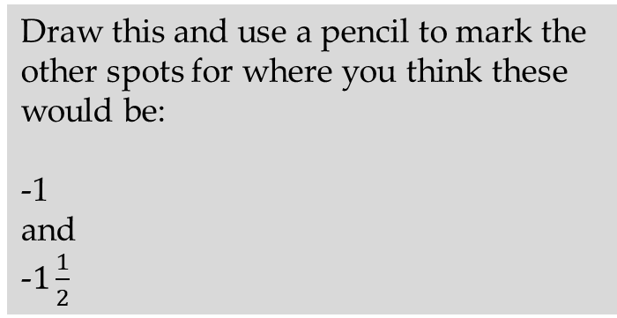
Topic: Negative Fractions
EQ: How do we add and subtract negative fractions?
Locations on a number line
1
2
Draw this and use a pencil to mark the other spots for where you think these would be:
-1
and
-$1\frac{1}{2}$

Slide 4
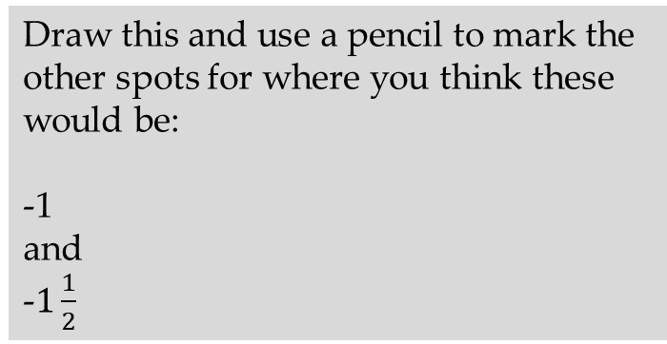
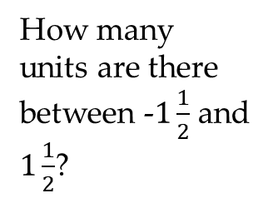
Topic: Negative Fractions
EQ: How do we add and subtract negative fractions?
Locations on a number line
-2
-1
0
1
2
Identifying where zero is helpful because
the number line is symmetrical around zero.
Draw this and use a pencil to mark the other spots for where you think these would be:
-1
and
-$1\frac{1}{2}$
How many units are there between -$1\frac{1}{2}$ and $1\frac{1}{2}$?
3 units

Slide 5
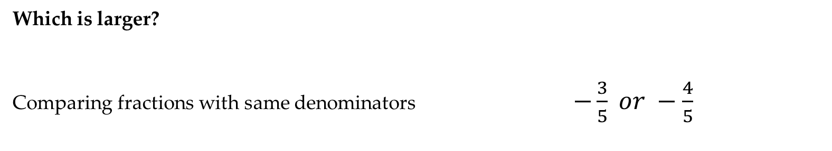
Topic: Negative Fractions
EQ: How do we add and subtract negative fractions?
Comparing Fractions
Which is larger?
Comparing fractions with same denominators $−\frac{3}{5} or −\frac{4}{5}$
Strategy 1
Strategy 2
Comparing fractions with same numerators $−\frac{6}{7} or −\frac{6}{9}$
Comparing fractions by converting to equivalent fractions $−\frac{5}{8} or −\frac{3}{4}$
Strategy 3
Strategy 4
Comparing both to one half (or negative) $−\frac{6}{13} or −\frac{5}{9}$
Comparing both to 1 (or negative) $−\frac{5}{6} or −\frac{3}{4}$
Strategy 5

Slide 6
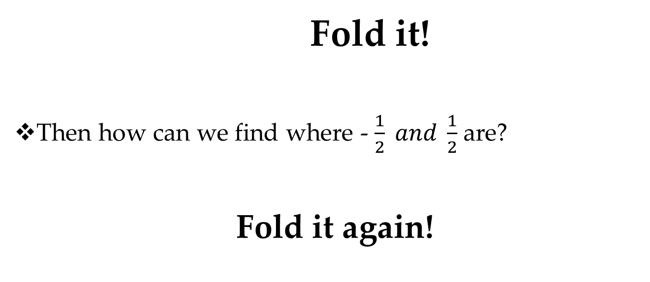
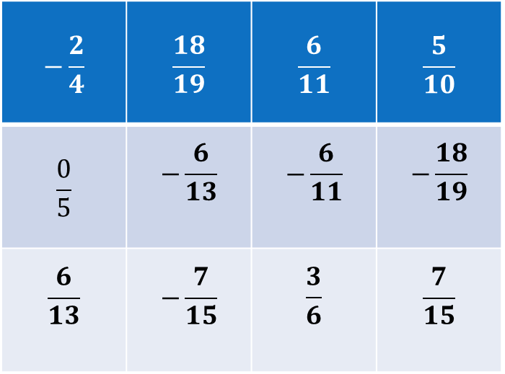
Using the strips of paper we will make a number line
Put -1 and 1 on the ends
How could we accurately find where zero is?
Fold it!
Then how can we find where - $\frac{1}{2} and \frac{1}{2}$ are?
Fold it again!
Use the strategies to find where these should go!
$$−\frac{2}{4}$$ | $$\frac{18}{19}$$ | $$\frac{6}{11}$$ | $$\frac{5}{10}$$
$$\frac{0}{5}$$ | $$−\frac{6}{13}$$ | $$−\frac{6}{11}$$ | $$−\frac{18}{19}$$
$$\frac{6}{13}$$ | $$−\frac{7}{15}$$ | $$\frac{3}{6}$$ | $$\frac{7}{15}$$
Notes:
Using the strips of paper students will write -1 and 1 at the ends and fold in half to mark the 0 point then half again for -1/2 and +1/2 then they will place the numbers on the line where they think they will go.
As a class do it on the board or as the warm up for the next lesson.
Have the students glue them in.

Slide 7
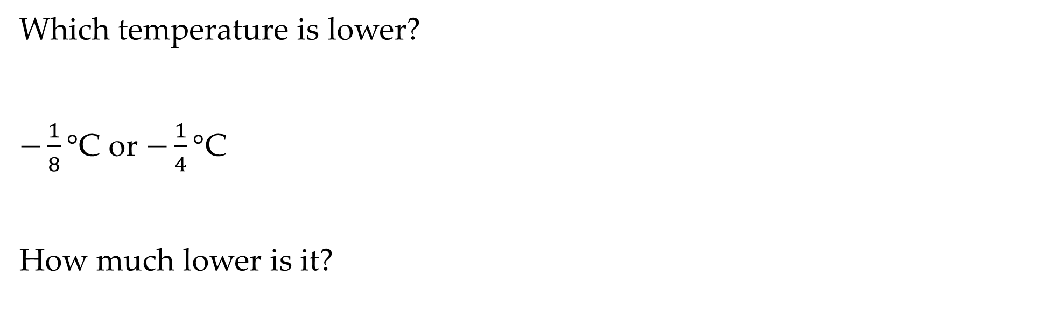
Summary- Exit Pass
Which temperature is lower?
$−\frac{1}{8}°$C or $−\frac{1}{4}°$C
How much lower is it?

